Slide 1
AI Literacy Project Taster Day — Queen Mary University of London
Dr Devis Di Tommaso
Reader in Computational Chemistry
d.ditommaso@qmul.ac.uk

Slide 2
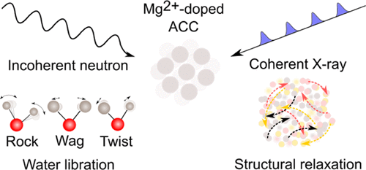


Who am I?
Dr Devis Di Tommaso
d.ditommaso@qmul.ac.uk
Office 1.04, Joseph Priestley
Department of Chemistry, QMUL
Computational chemistry, Machine Learning, Computational Electrocatalysis, Nucleation & growth, CO₂ utilisation
‪Devis Di Tommaso‬ - ‪Google Scholar‬
London’s Thomas Young Centre for the Theory & Simulation of Materials
www.thomasyoungcentre.org

Slide 3
QMUL COMP-TEACH
https://hub.comp-teach.qmul.ac.uk/

Slide 4
Jupyter notebooks
https://github.com/ditommas/IT-Literacy-Project

Slide 5
Today’s activities
Overview of machine learning (ML)
Jupyter notebook: House Price Prediction
Representation of molecules
Jupyter notebook: Smiles
Jupyter notebook: Fingerprints
Jupyter notebook: ML in Chemistry, Fingerprints

Slide 6
Overview of Machine Learning
Artificial Intelligence vs Machine Learning
AI: The field focused on building systems that exhibit intelligent behaviour
ML: A subset of AI that enables systems to learn patterns and make predictions by fitting mathematical models to observed data
For example, Deep Learning: A branch of ML where deep neural networks are trained on large datasets; the training process is called model fitting

Slide 12
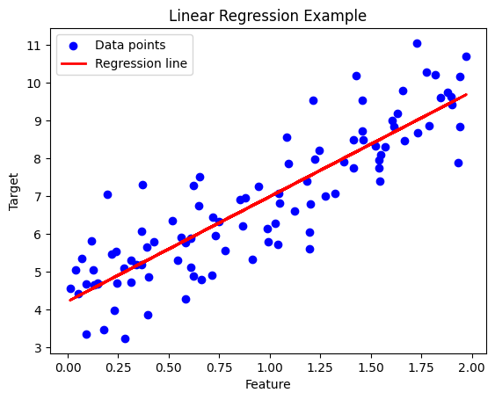
Supervised learning
Creation of a model that maps known inputs to known outputs
Example: linear regression
One starts with a series of training data that consists of the inputs and associated outputs
Supervised learning using linear regression:
Blue dots are the data points
Red line is the regression line that best fits the data
Linear regression predicts the value of a target variable based on the value of an input feature.
The regression line shows the relationship between the feature and the target

Slide 13
What is a supervised learning model?
An equation relating input (age) to output (height)
Search through family of possible equations to find one that fits training data well

Slide 14
Example: 1D Linear regression model
Model:
Parameters
y-offset
slope

Slide 15
Example: 1D Linear regression model
Model:
Parameters
y-offset
slope

Slide 16
Example: 1D Linear regression model
Model:
Parameters
y-offset
slope

Slide 17
Example: 1D Linear regression model
Model:
Parameters
y-offset
slope

Slide 18
Example: 1D Linear regression training data

Slide 19
Example: 1D Linear regression training data
Loss function:
“Least squares loss function”

Slide 20
Example: 1D Linear regression loss function
Loss function:
“Least squares loss function”

Slide 21
Example: 1D Linear regression loss function
Loss function:
“Least squares loss function”

Slide 22
Example: 1D Linear regression loss function
Loss function:
“Least squares loss function”

Slide 23
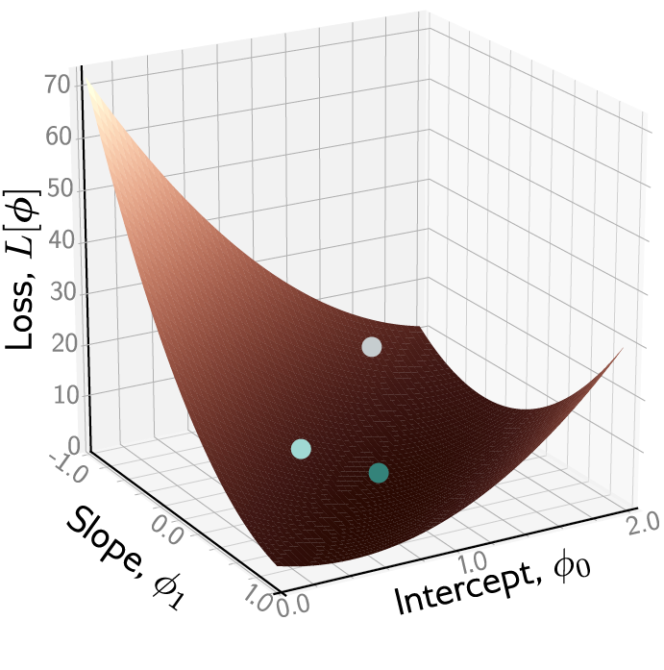
Example: 1D Linear regression loss function
Loss function:
“Least squares loss function”

Slide 24
Example: 1D Linear regression loss function

Slide 25
Example: 1D Linear regression loss function

Slide 26
Example: 1D Linear regression loss function

Slide 27
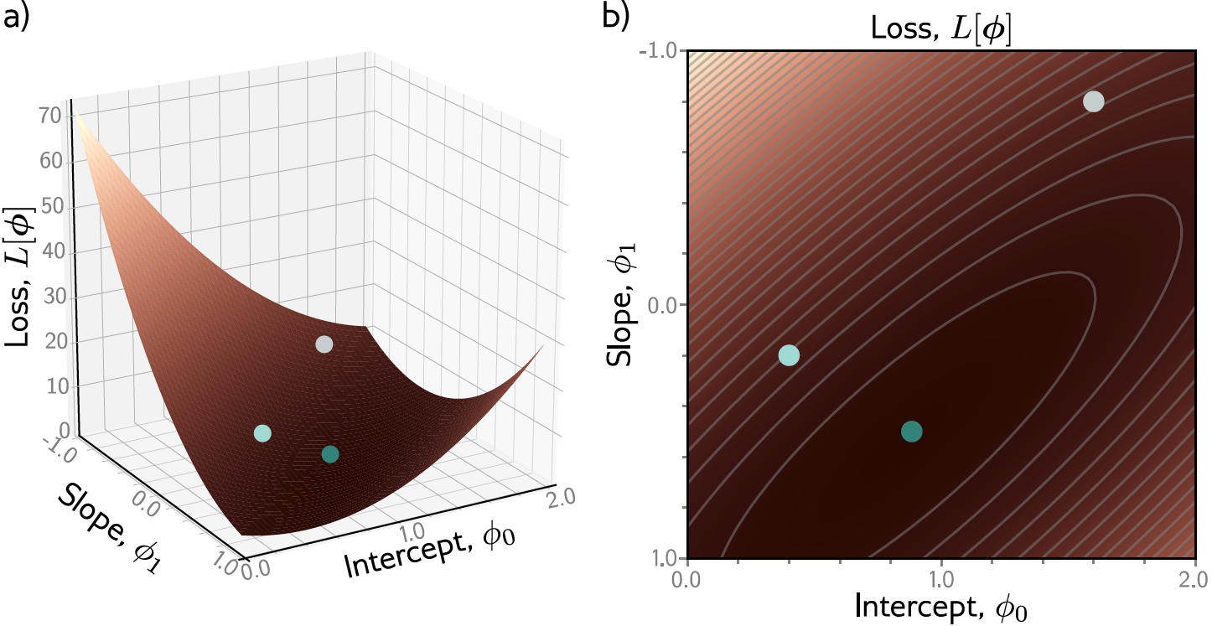
Example: 1D Linear regression loss function

Slide 28
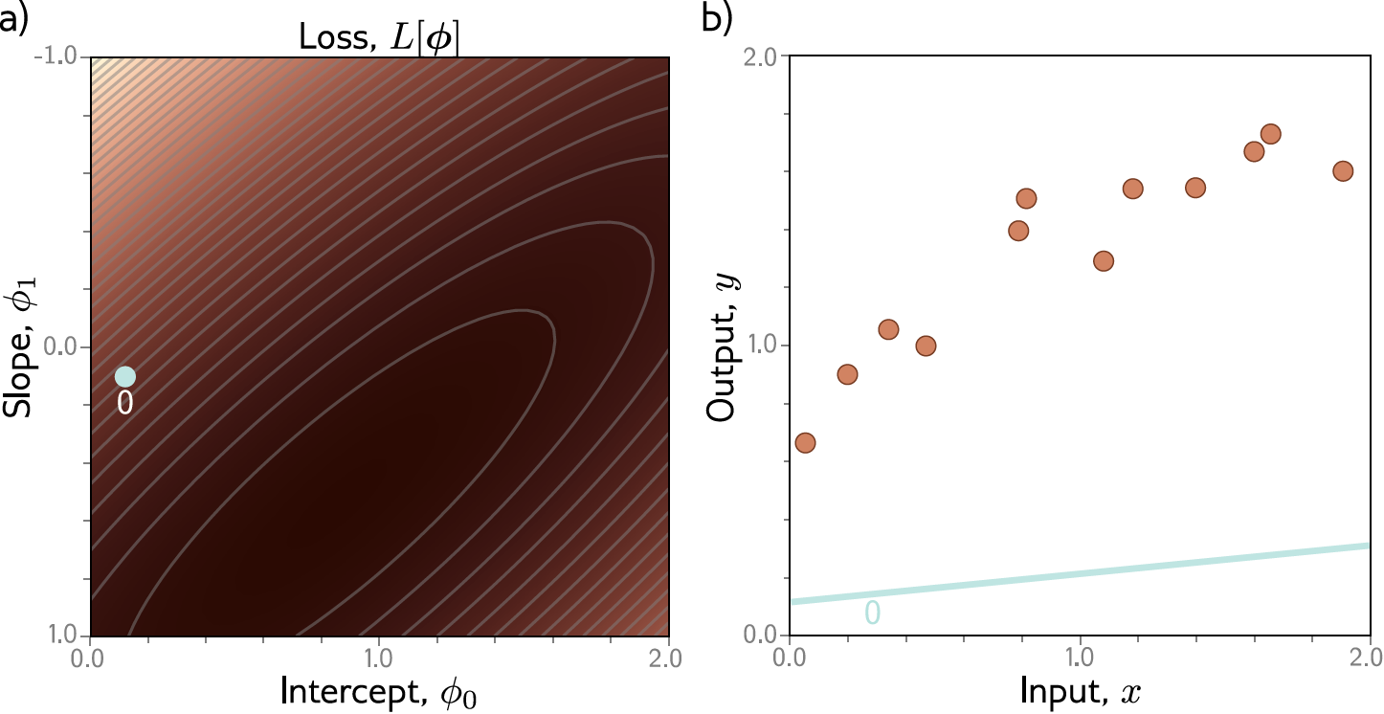
Example: 1D Linear regression training

Slide 29
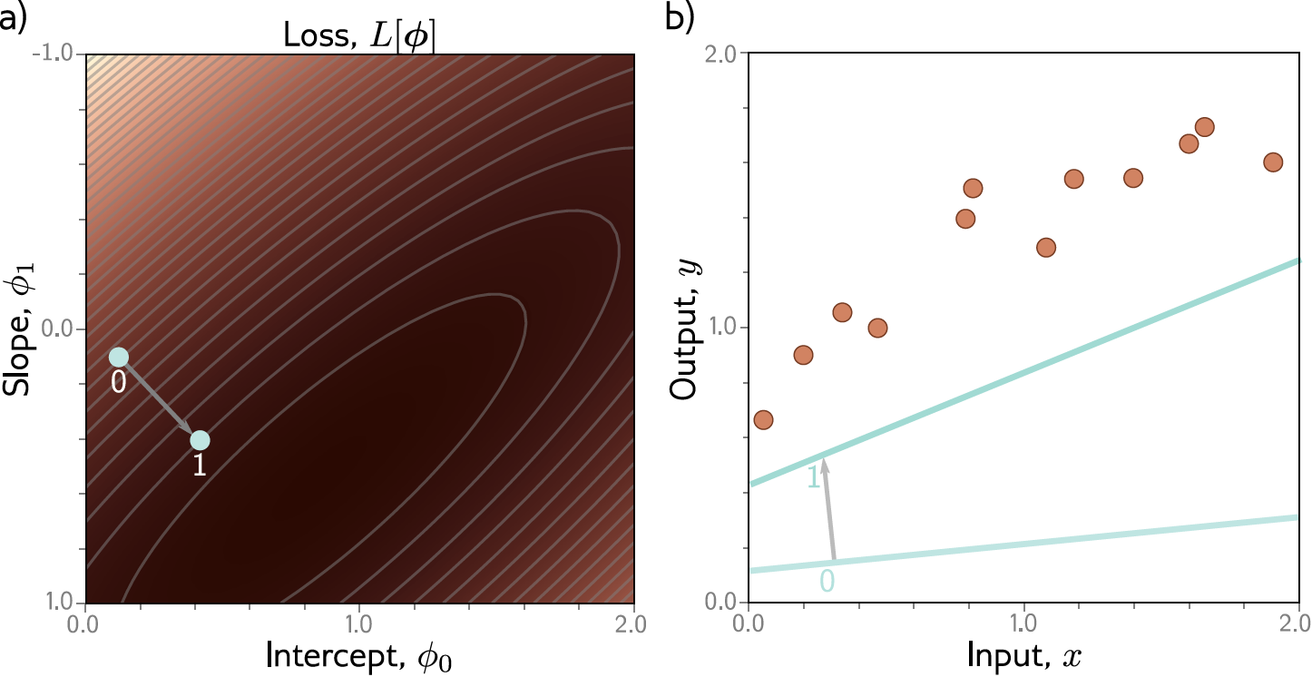
Example: 1D Linear regression training

Slide 30
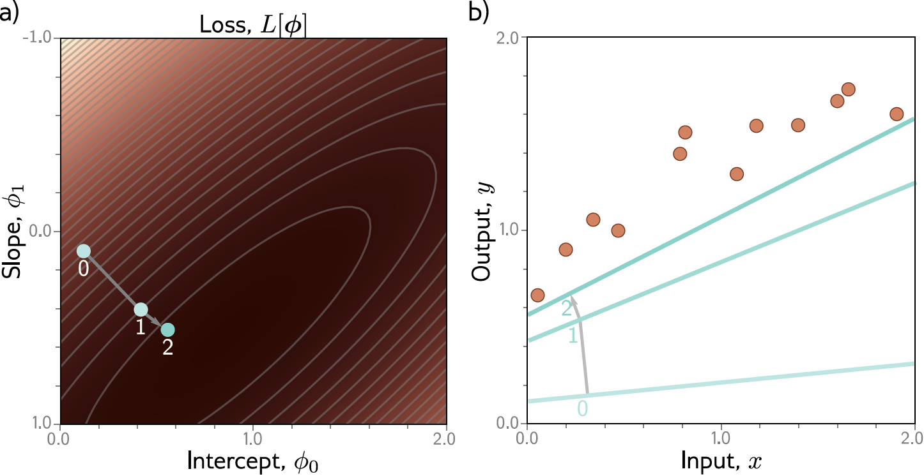
Example: 1D Linear regression training

Slide 31

Example: 1D Linear regression training

Slide 32
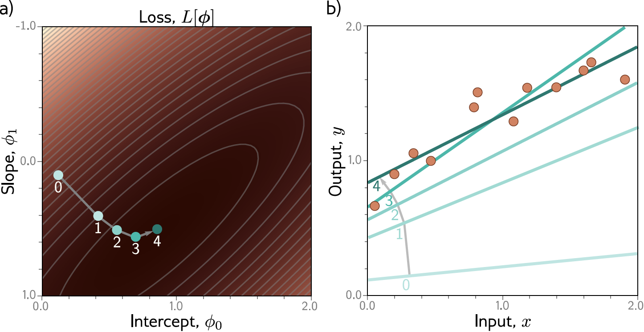
Example: 1D Linear regression training
This technique is known as gradient descent

Slide 33
Regression
Univariate regression problem (one output, real value)

Slide 34
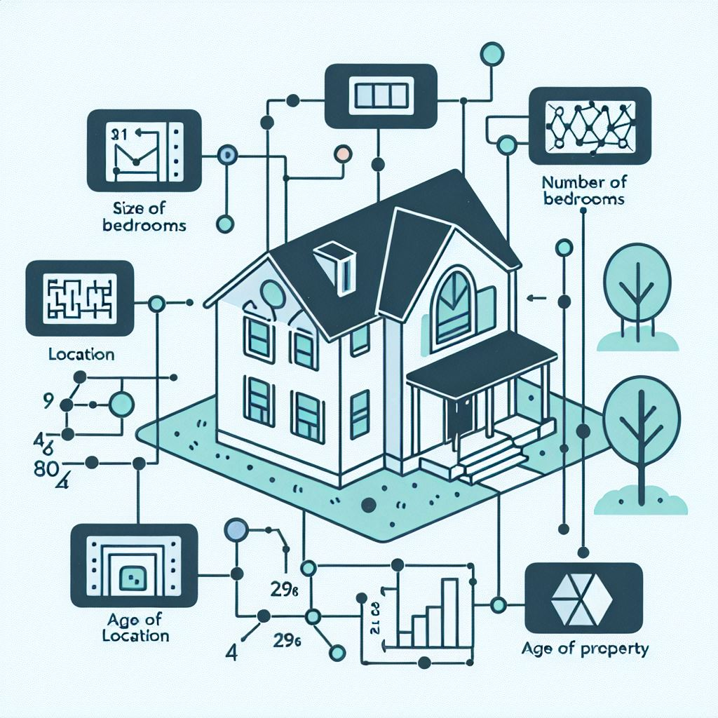
Machine Learning terminology
Features and Dimensionality
Features (or descriptors): Measurable properties or characteristics of the data used to train ML models. They strongly influence model performance.
Example – Predicting House Prices Possible features:
Size of the house (square feet/meters)
Number of bedrooms
Location (neighbourhood, proximity to amenities)
Age of the property
Lot size
Dimensionality: The number of input features in a dataset. In this example, dimensionality = 5

Slide 35
Jupyter notebook: House Price Prediction
https://github.com/ditommas/IT-Literacy-Project
https://github.com/ditommas/IT-Literacy-Project/tree/main/01_house_prices

Slide 36
QMUL COMP-TEACH
https://hub.comp-teach.qmul.ac.uk/

Slide 37

Your QMUL username
Your QMUL password

Slide 38
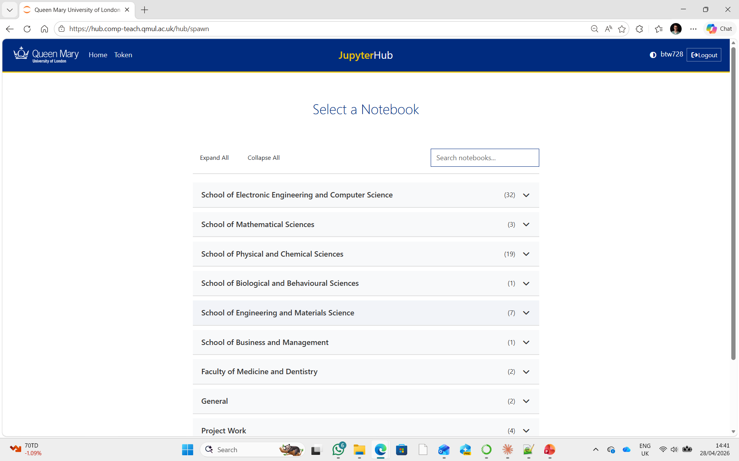

Slide 39
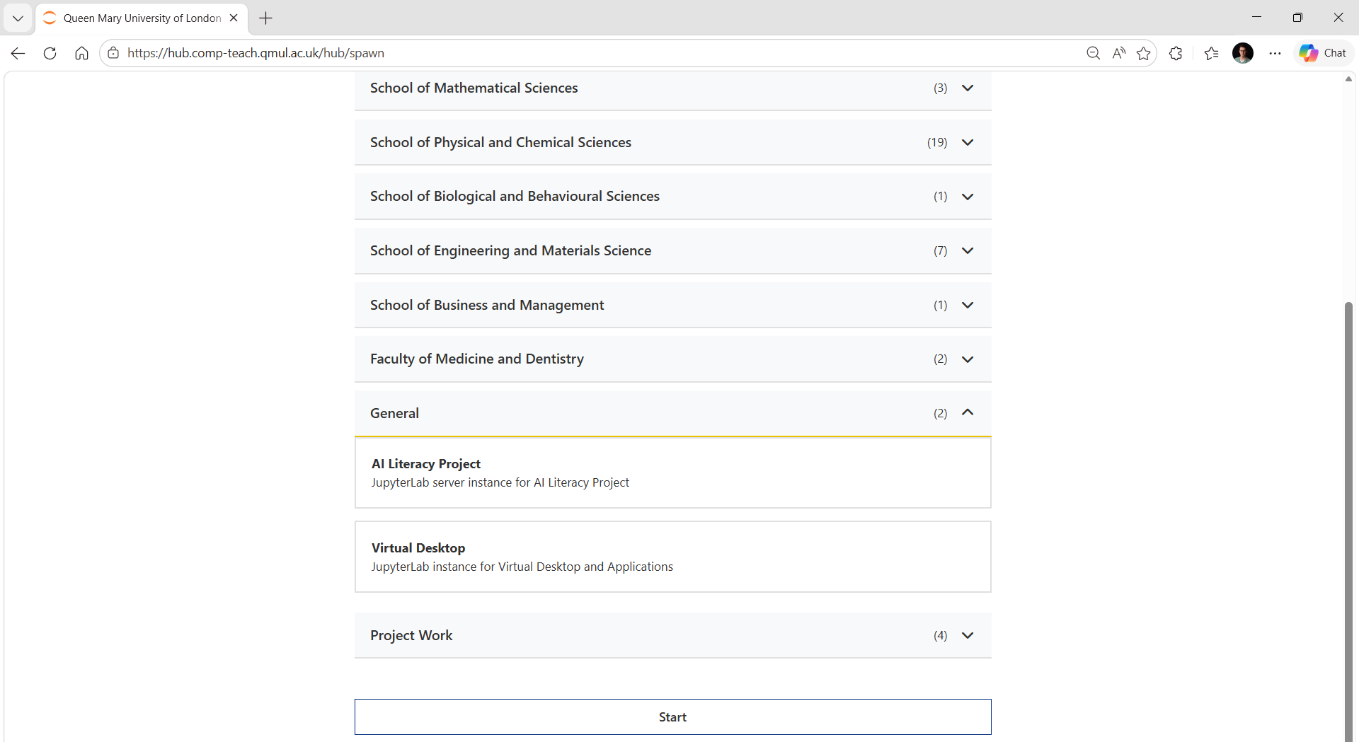
Scroll down

Slide 40
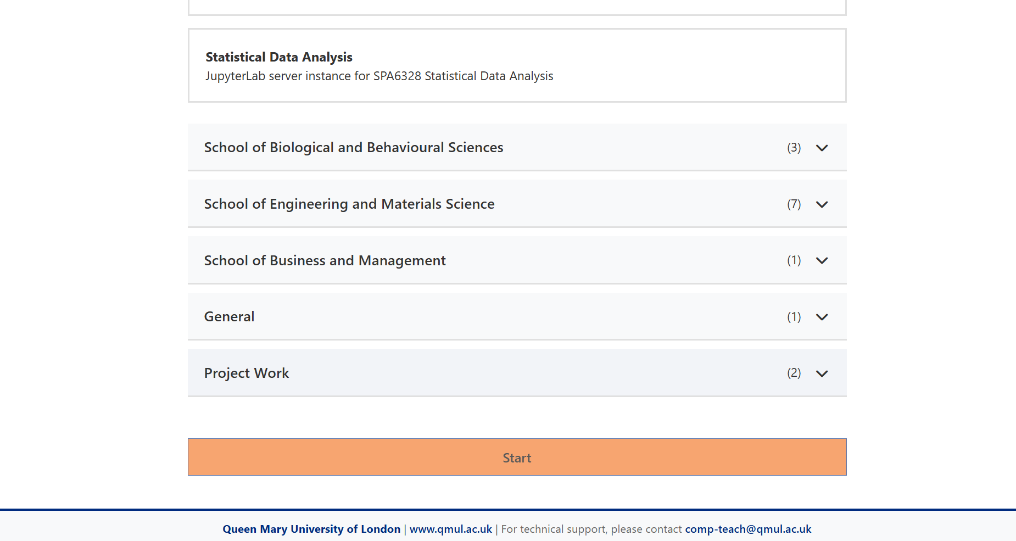

Slide 41
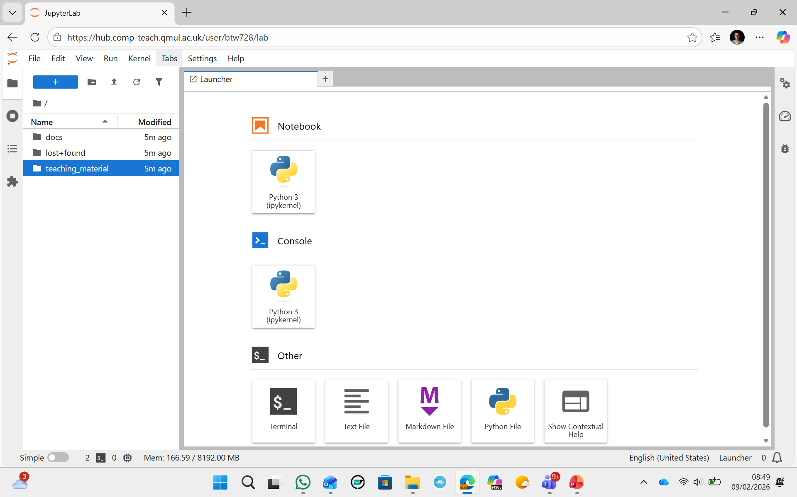
To open a Jupyter notebook

Slide 42
Text classification
Binary classification problem (two discrete classes)
Transformer network

Slide 43
Music genre classification
Multiclass classification problem (discrete classes, >2 possible values)
Recurrent neural network (RNN)

Slide 44
Image classification
Multiclass classification problem (discrete classes, >2 possible classes)
Convolutional network

Slide 45
Graph regression
Multivariate regression problem (>1 output, real value)
Graph neural network

Slide 46
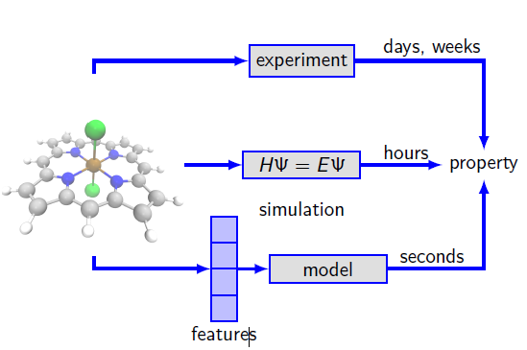
Structure property relationships
Given the emphasis on the relationship between structure and function in materials chemistry, the adoption of ML by chemists is natural

Slide 47
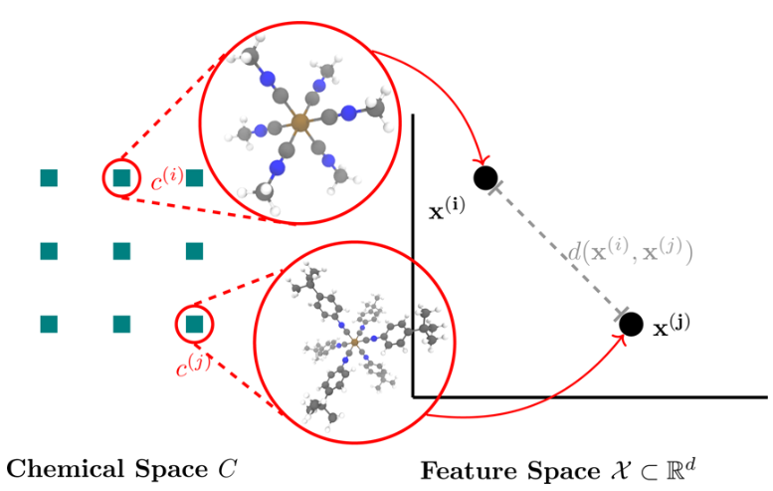
Representations of Molecules

Slide 48
Representations of Molecules (SMILES)
Introduced by Weininger (1988)
Designed to meet the needs of modern chemical information processing
Key Features
Minimal and natural grammar
Enables compact, human-readable representation of molecules
SMILES is the de facto standard representation in cheminformatics

Slide 49
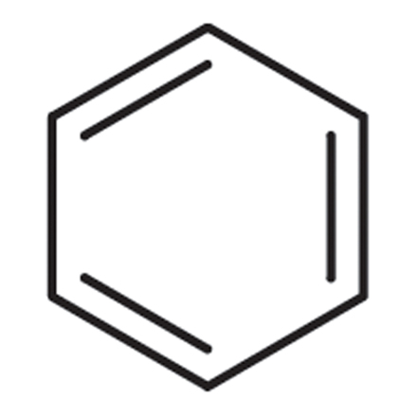
From SMILES to Molecular Descriptors with RDKit (Molecular descriptors = numerical features representing molecular properties)
Descriptors from RDKit
MolWt
ExactMolWt
HeavyAtomCount
HeavyAtomMolWt
NHOH Count
NumHAcceptors
NumHDonors
NumHeteroatoms
NumRotatableBonds
NumValenceElectrons
NumAmineBonds
https://www.rdkit.org/docs/GettingStartedInPython.html

Slide 50
Jupyter notebook: SMILES
https://github.com/ditommas/IT-Literacy-Project
https://github.com/ditommas/IT-Literacy-Project/tree/main/02_smiles

Slide 51
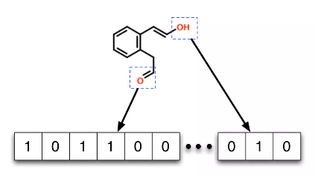
Molecular Fingerprints (computer-readable representations of molecules as binary vectors)
Format: A fixed-length vector (e.g., 1024 or 2048 bits)
Encoding: Each bit represents a chemical feature:
Atom environments
Bond connectivity
Functional groups
Topological paths or circular neighbourhoods
Types:
Path-based fingerprints (e.g., RDKit’s RDKFingerprint)
Circular fingerprints (e.g., Morgan/ECFP)
Substructure fingerprints (e.g., MACCS keys)

Slide 52
Jupyter notebook: Fingerprints
https://github.com/ditommas/IT-Literacy-Project
https://github.com/ditommas/IT-Literacy-Project/tree/main/03_fingerprints

Slide 53
Jupyter notebook: ML in chemistry
https://github.com/ditommas/IT-Literacy-Project
https://github.com/ditommas/IT-Literacy-Project/tree/main/04_ml_chemistry
QM9 dataset:
https://moleculenet.org/datasets-1

